Slide 1
MoDOT Bridge Program Fiscal Years 2019 - 2023
Missouri Department of Transportation
November 1, 2018

Slide 2
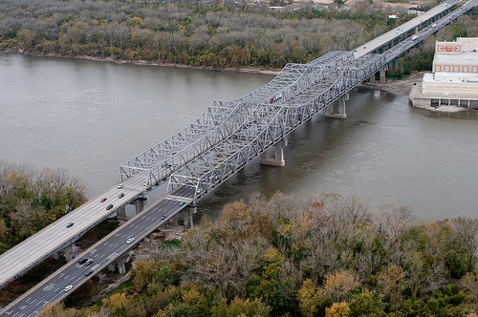
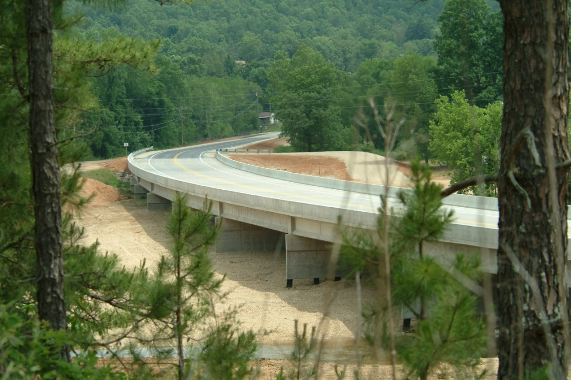
Bridges: Typical or Major
Typical Bridges are those under 1,000-feet long. – 10,177
Major Bridges are over 1,000-feet long. – 208

Slide 3
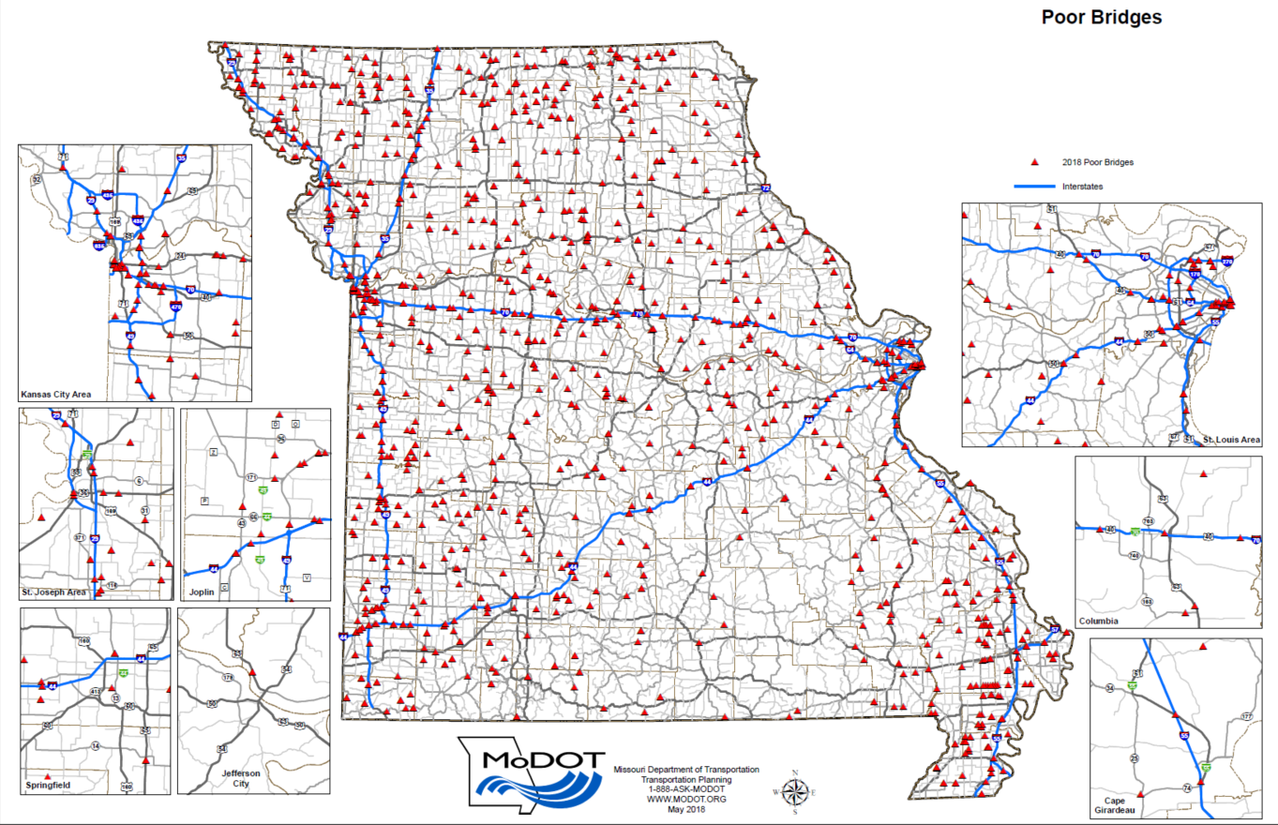
922 Poor Bridges

Slide 4
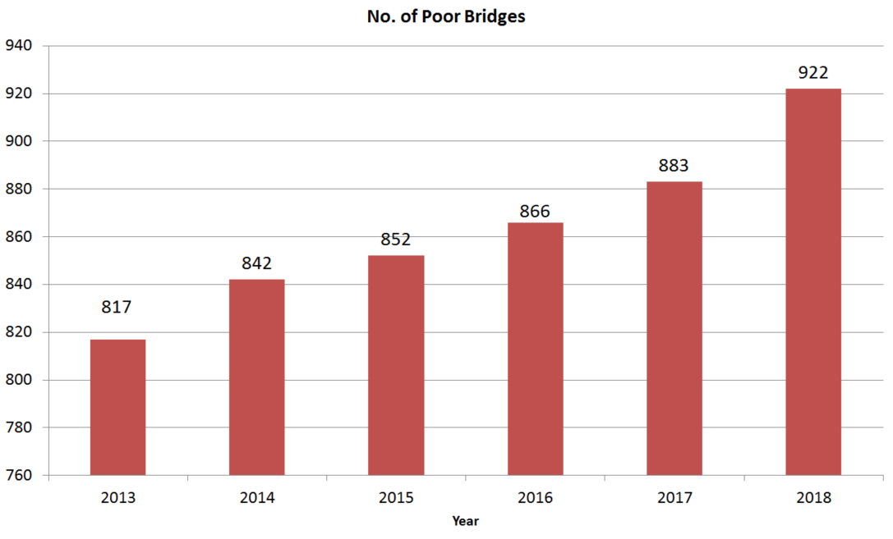
922 Poor Bridges

Slide 5
Poor Bridges
We spent about $400 million on Bridges over the last two years.
Why is the number of Poor bridges still increasing?

Slide 6
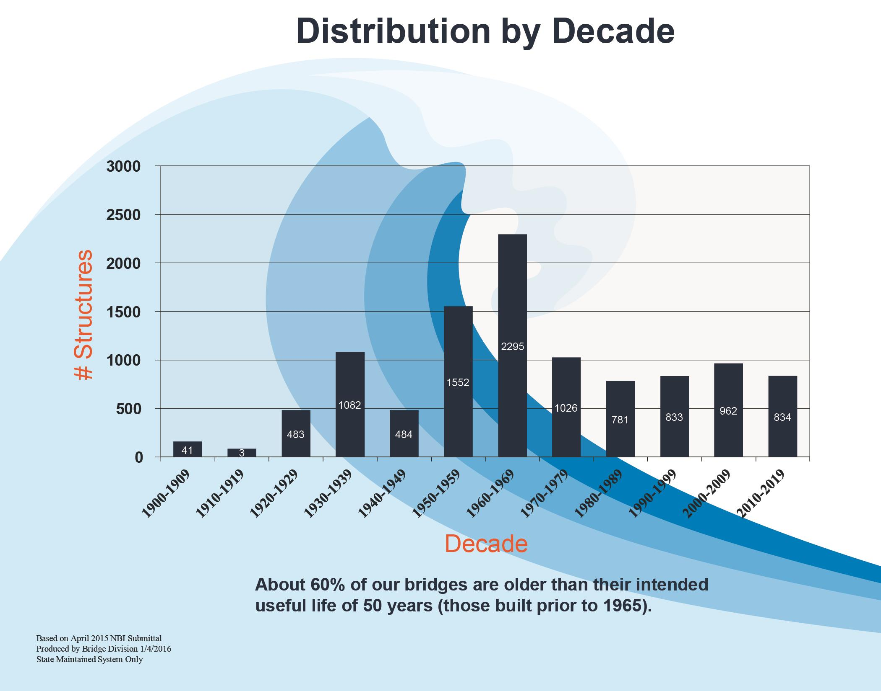

Slide 7
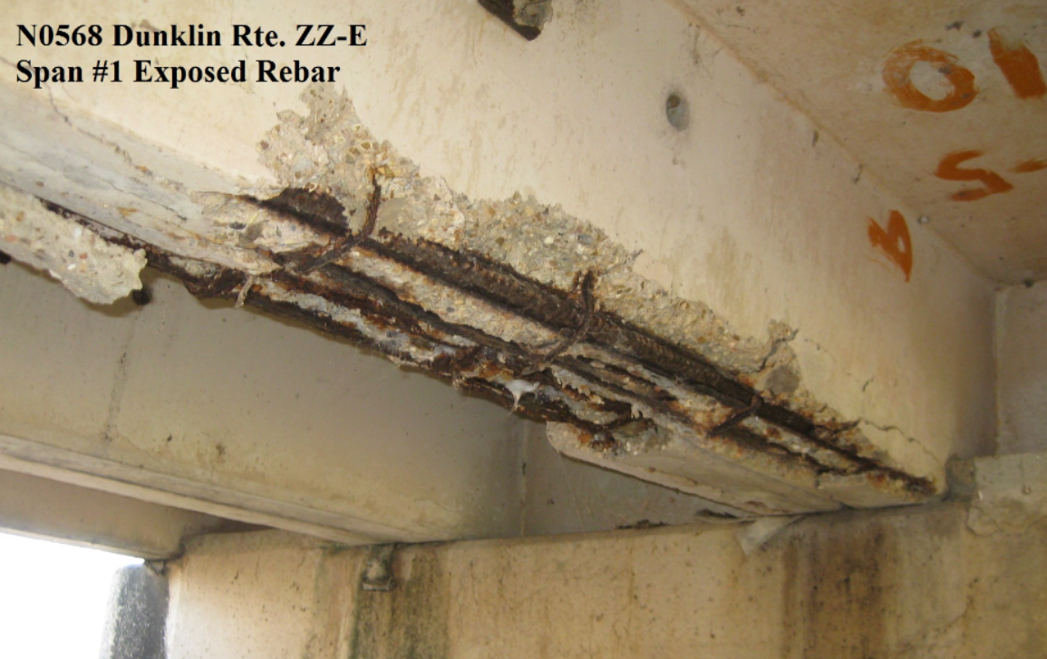
Poor Bridges
Route ZZ over N. Deering Drainage Ditch in Dunklin County
20-Ton Weight Limit

Slide 8
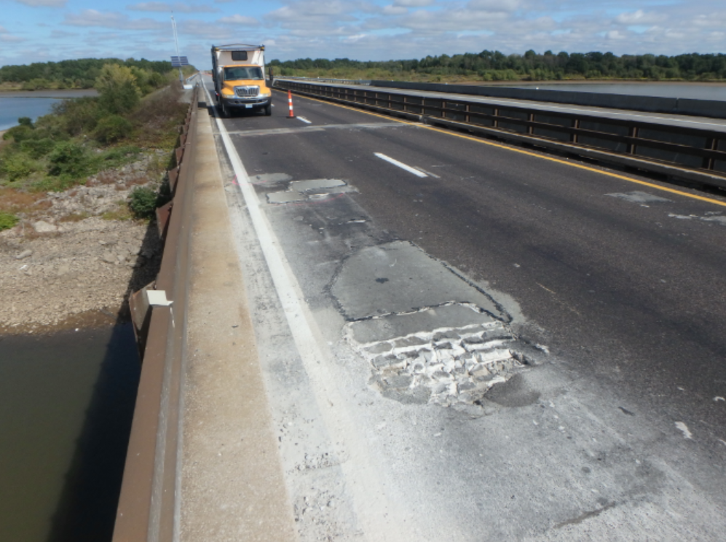
Poor Bridges
Route 13 over Truman Lake in Henry County
Getting new overhangs and Barriers

Slide 9
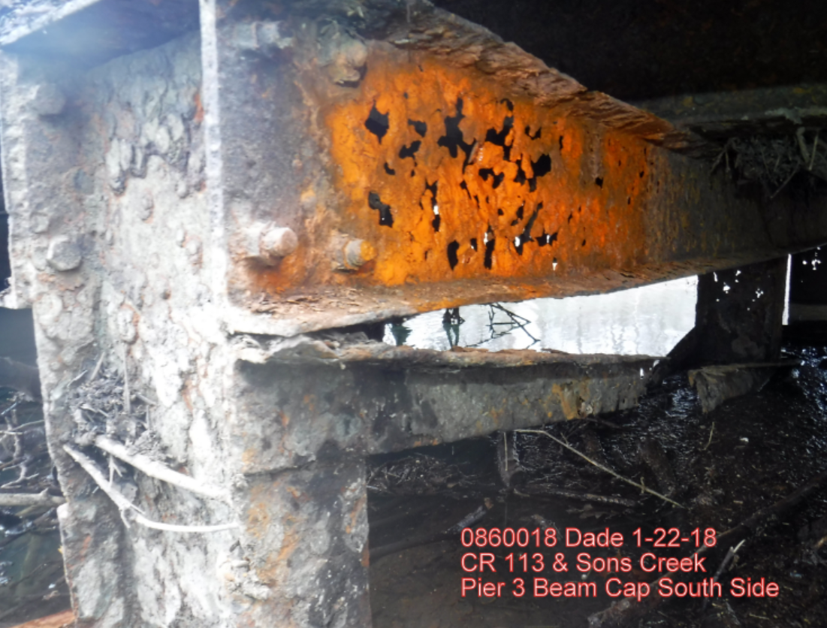
Poor Bridges
County Road 113 over Sons Creek in Dade County
Currently closed to traffic

Slide 10
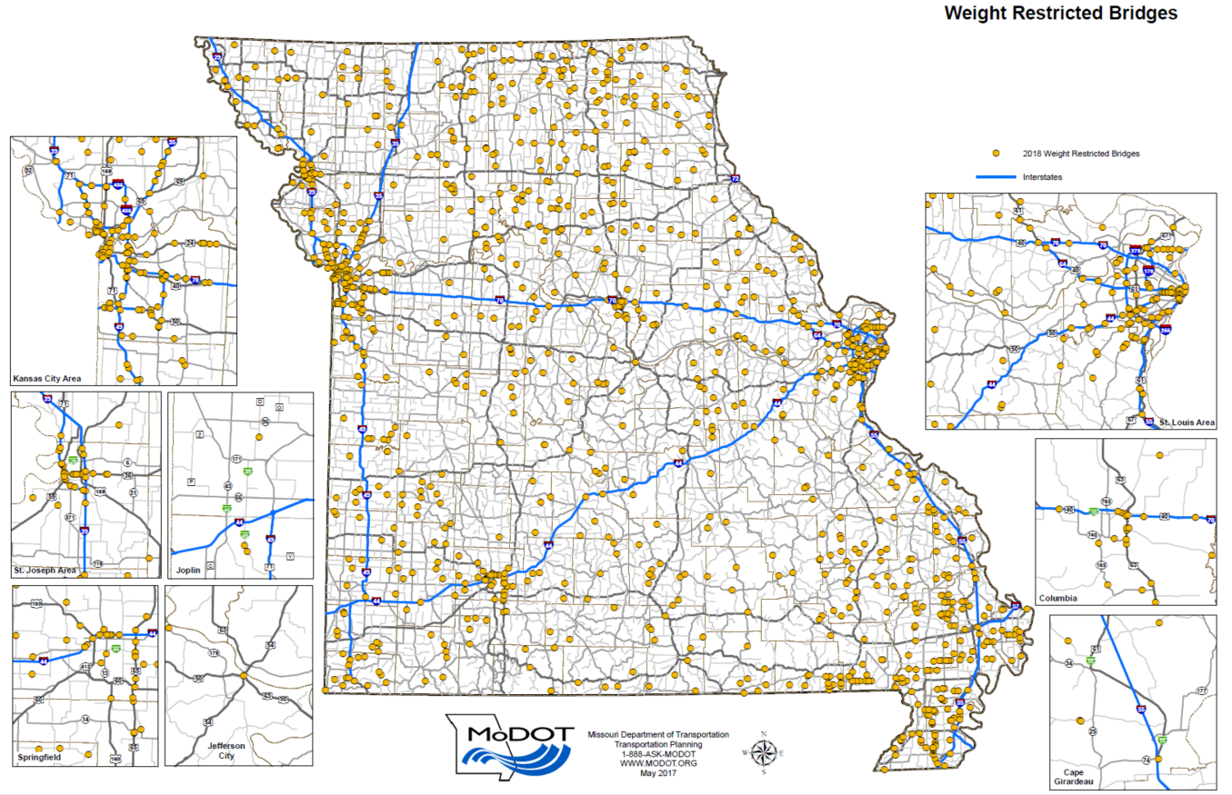
1,194 Weight- Restricted Bridges

Slide 11
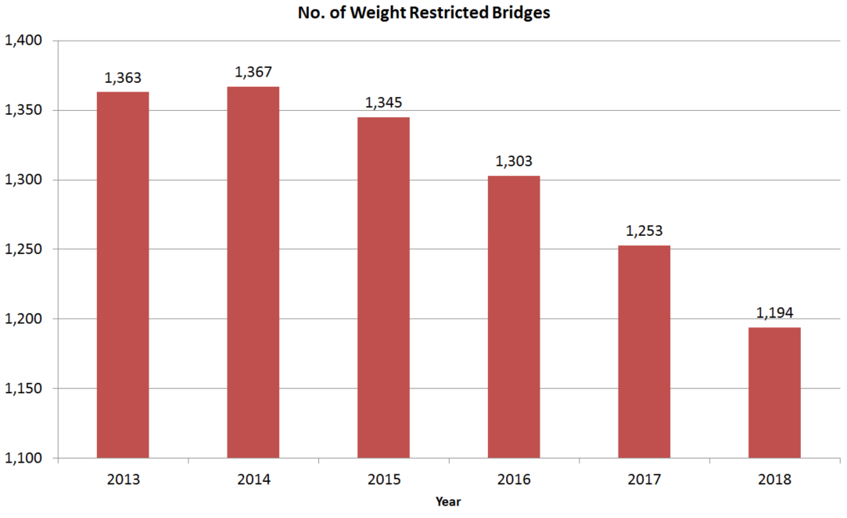
1,194 Weight-Restricted Bridges

Slide 12
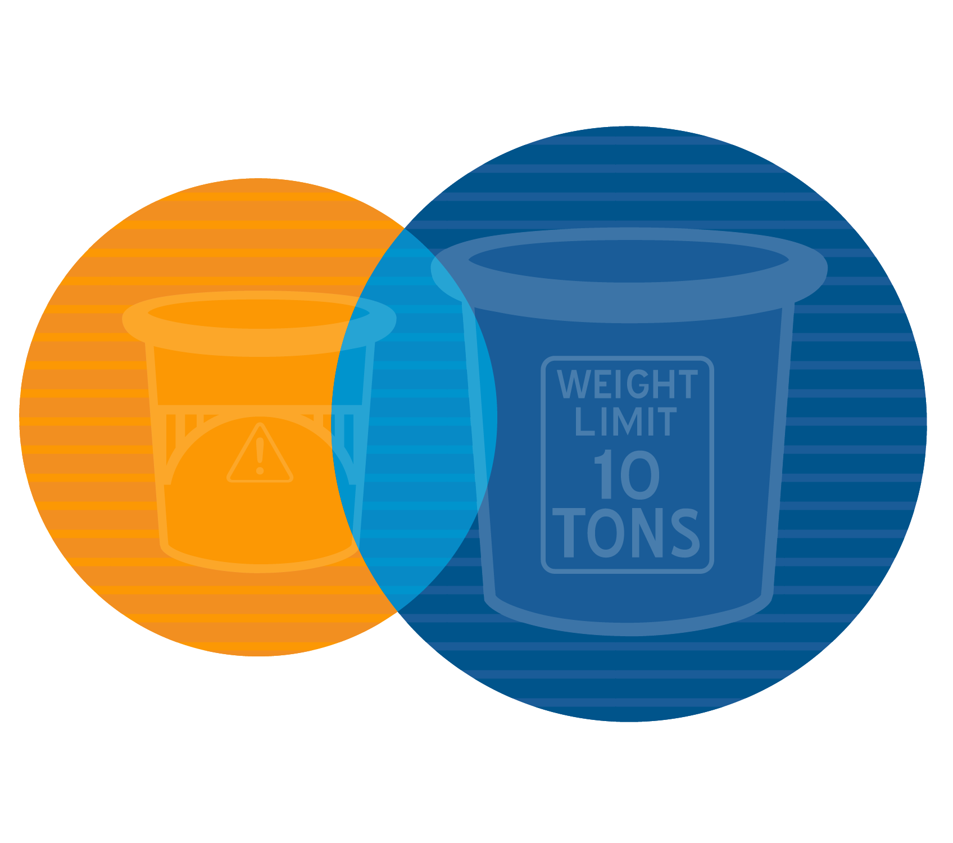
Poor & Weight-Restricted Bridges
1,194 WEIGHT RESTRICTED BRIDGES
922 POOR BRIDGES
450
BOTH

Slide 13
Notes:
Revenues
Motor fuel taxes
Annual growth rates of 0.25 percent in 2018-2021 and 0.0 percent in 2022 and beyond.
Based on gasoline and diesel fuel consumption projections from the U.S. Department of Energy’s Annual Energy Outlook 2017 (AEO 2017) for the region and historical data
Motor vehicle sales taxes
Annual growth rate is 4.5 percent in 2018-2023 and 4.0 percent in 2024 and beyond.
Based on real disposable income projections from the AEO 2017 and historical data
Motor vehicle & driver licensing fees
Annual growth rate is 1.25 percent.
Based on population over the age of 16 projections from the AEO 2017, driver licensing renewal data from the Department of Revenue and historical data
Interest and miscellaneous
Interest projections are based on monthly cash balances with a 1.5 percent earnings rate
Miscellaneous revenue is based on average annual receipts of $45 million plus reimbursements on partnering projects (Cost Share program increases to $30 million in 2021, $35 million in 2022, $40 million in 2023 and $45 million in 2024)
A total of $68 million less over the six-year period.

Slide 14
Notes:
Revenues
Federal
Obligation limitation based on FAST Act
$982 million in 2018
$1,005 million in 2019
$1,029 million in 2020 and each year, thereafter
Assumes local public agencies will fully utilize annual allocations
Assumes preventative maintenance projects of $40 million, annually
Able to match all federal funds

Slide 15
Notes:
Revenues
Motor fuel taxes
Annual growth rates of 0.25 percent in 2018-2021 and 0.0 percent in 2022 and beyond.
Based on gasoline and diesel fuel consumption projections from the U.S. Department of Energy’s Annual Energy Outlook 2017 (AEO 2017) for the region and historical data
Motor vehicle sales taxes
Annual growth rate is 4.5 percent in 2018-2023 and 4.0 percent in 2024 and beyond.
Based on real disposable income projections from the AEO 2017 and historical data
Motor vehicle & driver licensing fees
Annual growth rate is 1.25 percent.
Based on population over the age of 16 projections from the AEO 2017, driver licensing renewal data from the Department of Revenue and historical data
Interest and miscellaneous
Interest projections are based on monthly cash balances with a 1.5 percent earnings rate
Miscellaneous revenue is based on average annual receipts of $45 million plus reimbursements on partnering projects (Cost Share program increases to $30 million in 2021, $35 million in 2022, $40 million in 2023 and $45 million in 2024)
Federal
Obligation limitation based on FAST Act
$982 million in 2018
$1,005 million in 2019
$1,029 million in 2020 and each year, thereafter
Assumes local public agencies will fully utilize annual allocations
Assumes preventative maintenance projects of $40 million, annually
Able to match all federal funds
Expenditures
Operating Budget (Includes PS, FB and E&E)
5-year Pay Strategy
Projected retirement contributions of 58 percent
An 8.5% medical increase for active employees and 11.5 percent for retirees for 2018, 10 percent for active employees and 13 percent for retirees for 2019 and 7 percent for active employees and 10 percent for retirees for 2020 and beyond, based on data from the Medical Plan actuary
Annual increase of $7 million in each year, not cumulative, starting in 2020 to address equipment needs and $5 million more starting in 2023 to address needs for materials, equipment and facilities.
Debt service
Based on current annual debt service payments
Construction
Construction Awards
$850 million in 2018
$900 million in 2019 and thereafter
DBC – $40 million in 2018, $55 million in 2019, $50 million in 2020 and back down to $40 million in 2021 and thereafter
ROW – $15 million in 2018 and $10 million in 2019 and thereafter
Other state agencies (Highway Patrol and Department of Revenue)
Based on historical expenditure data plus 2.5 percent annual growth

Slide 16
Notes:
Construction Awards –same as previous forecast

Slide 17
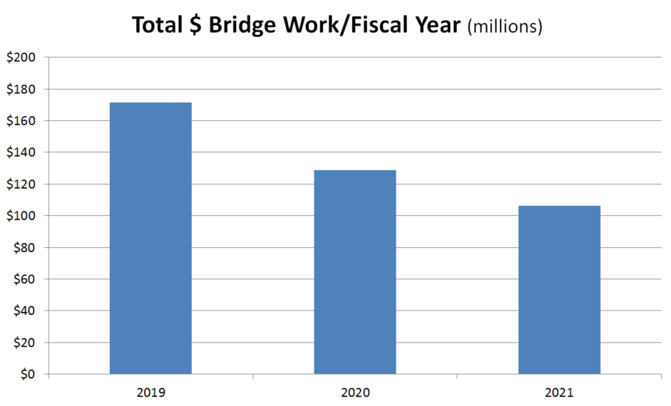
Bridge Work in STIP

Slide 18
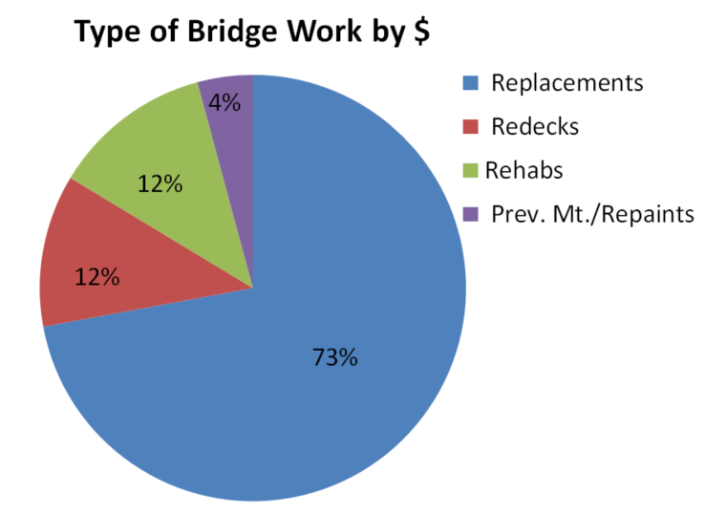
Bridge Work in STIP

Slide 19
Bridge Program
Bridge Work is Typically 25% of the Construction Program:
- 25% of $900 million is $225 million
- We can do $50 million per year in-house
- Need to outsource $175 million per year

Slide 20
Consultant Use
The Bridge Division is only staffed for a $250 million construction program.
We are just big enough to maintain a core competency in Bridge Design.

Slide 21
Consultant Use
Who Will Do the Outsourced Bridge Design:
- 67 Firms Prequalified for Bridge Design
- 40 Firms Have Gotten Work in Last 2 Years
- MoDOT has a statewide DBE goal of 15.38%

Slide 22
Consultant Use
In the Last 2 Years, We’ve Gone from 5 DBE Firms to 10:
- ABNA
- Civil Design
- David Mason & Associates
- EFK Moen
- Hg Consult
- Kaskaskia
- Leigh & O’Kane
- EDSI
- Premier Engineering
- Quigg Engineering

Slide 23
Consultant Use
How Will the Bridge Design be Outsourced:
- On call consultants are capped at $200K each.
- Expect 1 – 3 solicitations per month
- With 1 – 3 bridges per solicitation

Slide 24
Consultant Use
If the district is needing to outsource their part of a bridge project, we typically will outsource the bridge part as well.
We work hard to keep a variety of challenging bridge design projects in-house.

Slide 25
Roadway Width on Bridges
Match approach roadway including shoulders.
Minimum width is 24’.
Refer to EPG 231.8 for guidance.
Watch closely when doing scoping estimates.
There are still some 18’ wide bridges out there.

Slide 26
USGS StreamStats
water.usgs.gov/osw/streamstats/
Bridge Division started using April 1st.
Calculates drainage area and basin characteristics automatically.

Slide 27
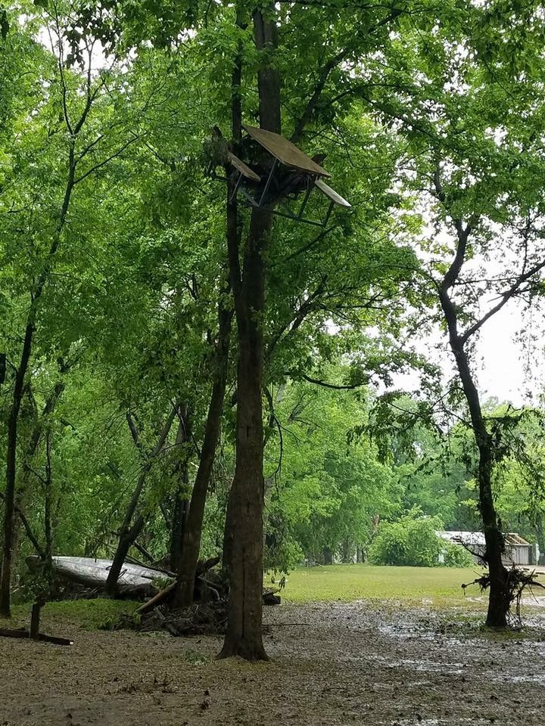
It’s very important
for districts to
record high
water marks.

Slide 28
Evolving Bridge Hydraulics
If you have 100 years of gage data, about 7 out of the 10 highest discharges are in the last 25 years.
We are seeing discharge increases of 30% - 50%.
Process has not changed.

Slide 29
MASH Bridge Barriers
By December 31, 2019 all bridge barriers constructed on NHS routes must meet the new MASH (Manual for Assessing Safety Hardware) standards.
Our “go to” bridge barrier will likely be 42” tall, single slope and 10” wide at the base.
We’ll need a shorter one for sight distance problem areas.

Slide 30
New Finger Plate Standards
Continue to have some problems with finger plate expansion devices not holding up.
New standard is heavier duty.
Small impact on working days due to closure pours.
Less than 5% of new bridges have finger plates.

Slide 31
Single Span Bridge Standards
More and more single span bridges.
Less complicated than multi-span.
How many designs would it take to cover 80%?
Would include steel and prestressed concrete.

Slide 32
Bridge Design Guidance
How Are These Shared with Consultants:
- Go to www.MoDOT.org
- Click on Doing Business with MoDOT
- Then Consultant Services
- Scroll Down to Bridge Information

Slide 33
Questions?
Dennis Heckman, State Bridge Engineer
Dennis.Heckman@modot.mo.gov
(573) 751-4676

